Slide 1
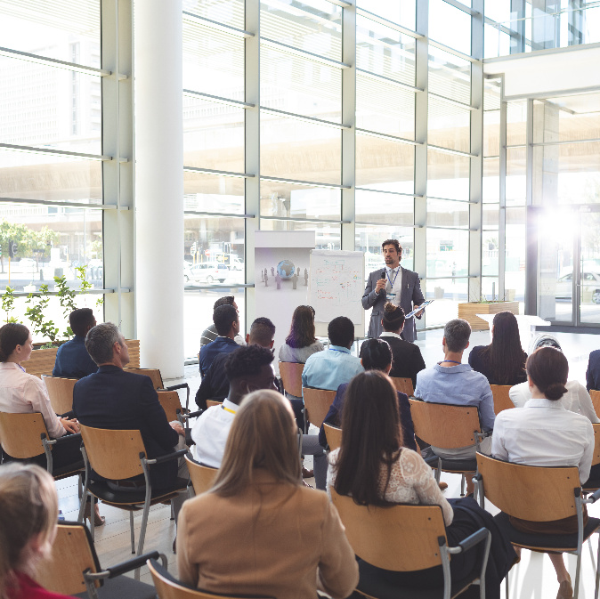
Future Ready AI Summit 2025
Saturday | May 10, 2025 9:30 AM - 4:30 PM

Slide 2

Future Ready AI Summit 2025
Saturday | May 10, 2025 9:30 AM - 4:30 PM

Slide 3
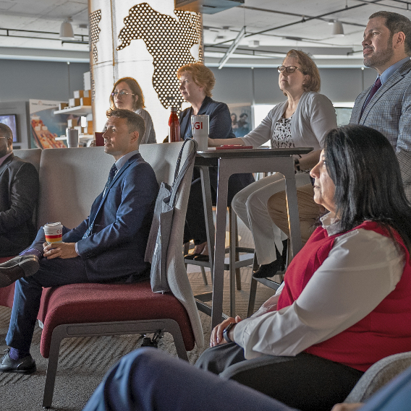
Future Ready AI Summit 2025
Saturday | May 10, 2025 9:30 AM - 4:30 PM

Slide 4




Agenda

Slide 5

Agenda
Time | Agenda item
00.00 AM – 00.00 PM | Agenda item
00.00 AM – 00.00 PM | Agenda item
00.00 AM – 00.00 PM | Agenda item
00.00 AM – 00.00 PM | Agenda item
00.00 AM – 00.00 PM | Agenda item
00.00 AM – 00.00 PM | Agenda item
00.00 AM – 00.00 PM | Agenda item
00.00 AM – 00.00 PM | Agenda item
00.00 AM – 00.00 PM | Agenda item

Slide 6
Agenda
1 | Insert agenda title Time
2 | Insert agenda title Time
3 | Insert agenda title Time
4 | Insert agenda title Time
5 | Insert agenda title Time
6 | Insert agenda title Time
7 | Insert agenda title Time
8 | Insert agenda title Time
9 | Insert agenda title Time
10 | Insert agenda title Time

Slide 7
Agenda
Time | Topic | Duration | Presenter
0:00 | Welcome | 00:00 | Name
0:00 | Text | 00:00 | Name
0:00 | Text | 00:00 | Name
0:00 | Text | 00:00 | Name
0:00 | Text | 00:00 | Name
0:00 | Text | 00:00 | Name
0:00 | Text | 00:00 | Name
0:00 | Break | 00:00
0:00 | Text | 00:00 | Name
0:00 | Text | 00:00 | Name
0:00 | Break | 00:00
0:00 | Text | 00:00 | Name
0:00 | Text | 00:00 | Name
0:00 | Meeting end | 00:00 | Name

Slide 8

Coffee break
00.00 – 00.00

Slide 9
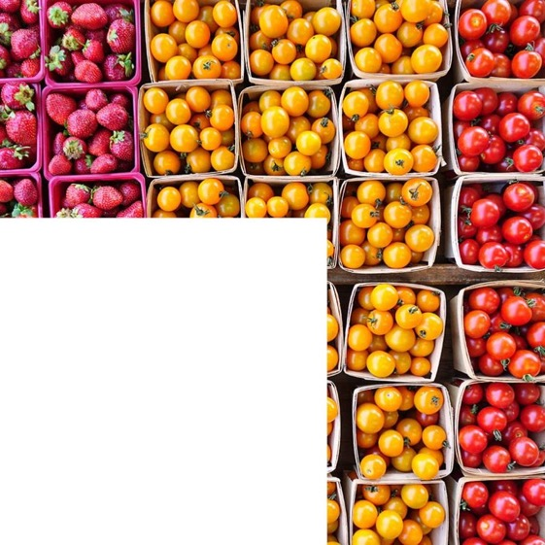
Lunch break
00.00 – 00.00

